Slide 1
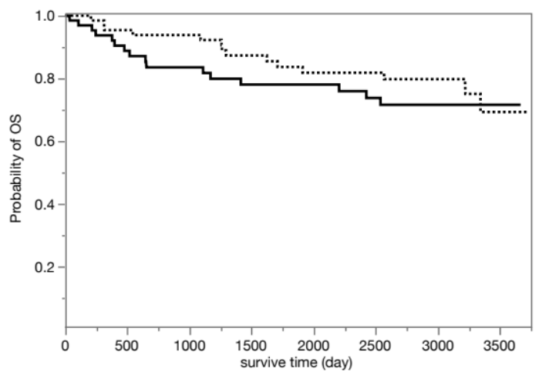
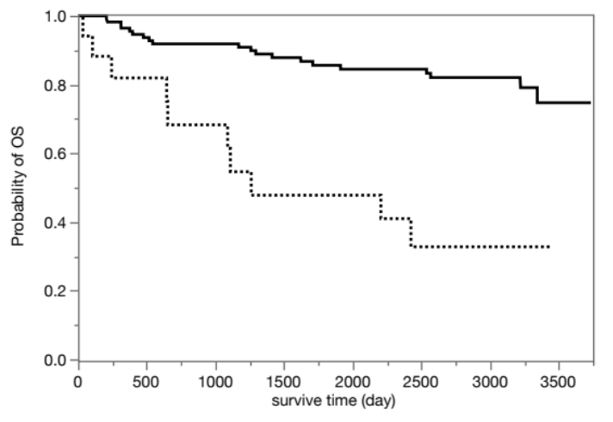
a)
b)
HSP47 expression positive (n=67)
HSP47 expression negative (n=66)
Low number of HSP47 positive fibroblasts (n=116)
High number of HSP47 positive fibroblasts (n=17)
Log-rank test: p=0.388
Log-rank test: p<0.001†
Additional file 1 . Survival curves of patients with lung cancer according to HSP47 expression or the number of HSP47 positive fibroblasts in patients with lung cancer. a) Patients with HSP47 expression positive and negative had no significant difference in overall survival (OS) curve (p=0.388, log-rank test) b) Patients have high number of HSP47 positive fibroblasts had significantly shorter OS (p<0.001 , log-rank test , cut-off value = 189 )

